Slide 1

FINANCIAL RETAIL ANALYTICS
Bank Term Deposit Prediction Model
Leveraging Random Forest Classification to predict customer conversion and optimize targeted marketing campaigns.

Slide 2

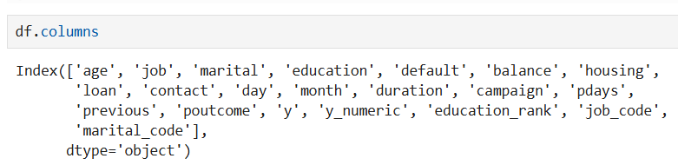

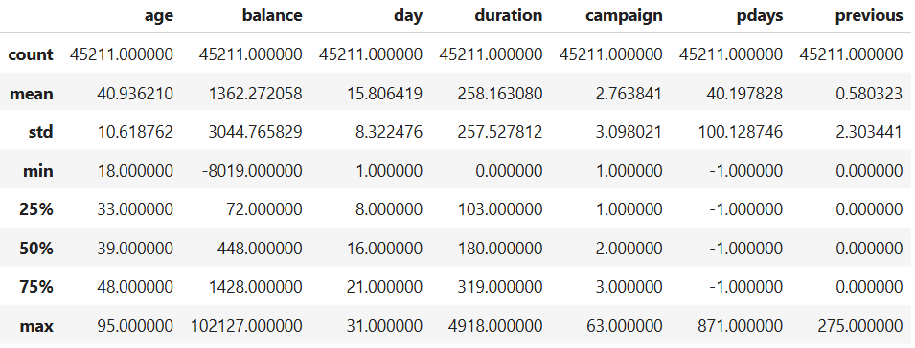
PROJECT OBJECTIVE & DATASET OVERVIEW
The Goal
Develop a robust predictive model to identify which existing bank clients are most likely to subscribe to a term deposit based on their demographics and prior campaign interactions.
Dataset: 45,211 records, 17 variables — Customer Demographics, Contact Metrics & Target ('y')

Slide 3

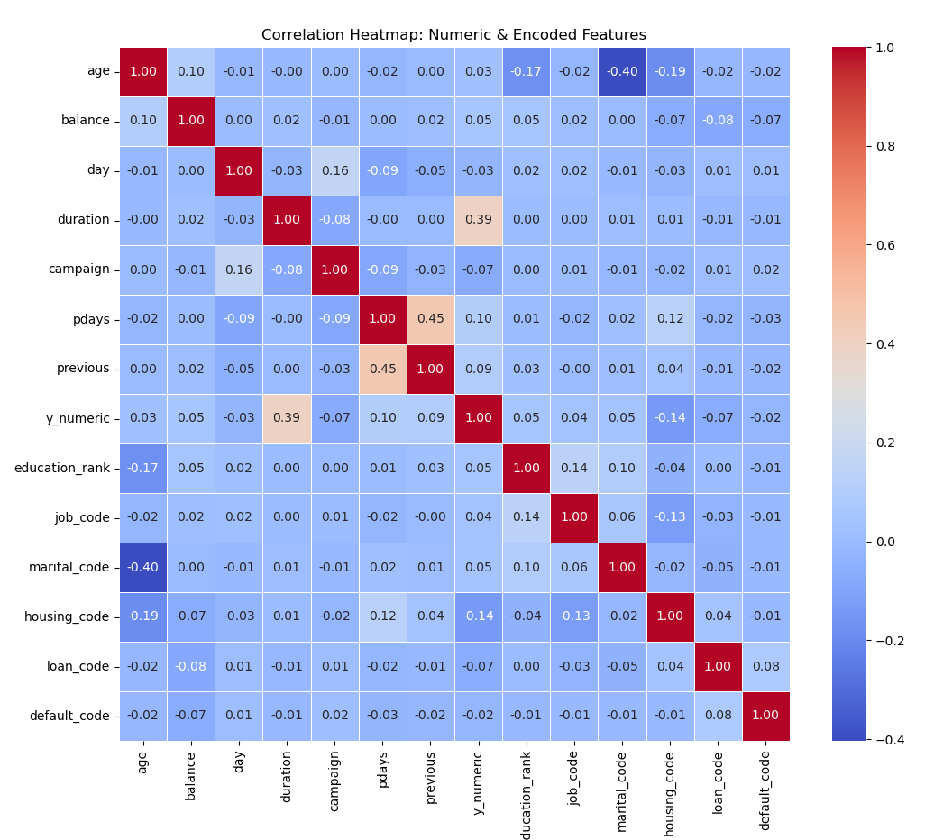

EXPLORATORY DATA ANALYSIS (EDA)
Discovering Relationships
▪
Target Imbalance: The target variable is heavily skewed, with a vast majority of customers declining the term deposit.
▪
Call Duration: Correlation analysis indicates that the duration of the last contact is heavily associated with a positive outcome.
▪
Financial Standing: Variables like 'balance' and 'housing loan' show distinct segmentation patterns between subscribers and non-subscribers.

Slide 4
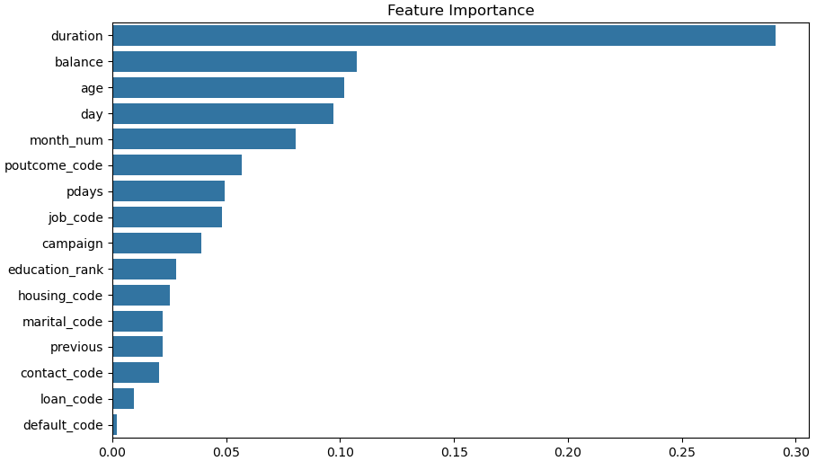

MODELING STRATEGY & FEATURE IMPORTANCE
Model Selection: A Random Forest Classifier was selected for its ability to handle non-linear relationships and provide clear feature interpretability.
80/20 train-test split applied.
Key Drivers (Top 3)
▪
Duration: Length of the marketing call.
▪
Balance: Average yearly balance.
▪
Age: Customer's age bracket.

Slide 5




PERFORMANCE METRICS & INFERENCE
0.9053
0.95
0.50
OVERALL ACCURACY
F1-SCORE (CLASS 0 - NO)
F1-SCORE (CLASS 1 - YES)
Metric Inference & The Imbalance Effect
While the model achieves a high overall accuracy of 90.53%, looking at precision and recall tells the true story. The model is highly precise (92%) and captures almost all (97%) of the clients who will not subscribe (Class 0). However, for actual conversions (Class 1), the recall is 0.40. This means the model currently misses about 60% of potential subscribers. This is a direct statistical consequence of the heavily imbalanced dataset (7985 negatives vs. 1058 positives in the test set).

Slide 6




PROJECT CONCLUSION & NEXT STEPS
Model Accuracy
Key Takeaway
Next Steps
Achieved a baseline accuracy of 90.53% using Random Forest, successfully identifying the primary demographic and behavioral drivers of conversion.
Call Duration is the strongest predictor of success. However, overall predictive power for the minority "Yes" class is constrained by data imbalance.
Implement sampling techniques like SMOTE (Synthetic Minority Over-sampling Technique) to balance the classes and improve the recall score for actual subscribers.

